Slide 1
Information Slide
“RFID and Facial Recognisation :Streamlined Attendence”

Slide 2

SMART ATTENDANCE USING RFID AND FACE DATA
Presented by:
22491A0470 Bailadugu Bhuvaneswari
22491A04W3 Vadlamudi Vanaja
22491A04L3 Kanagala Poojitha
22491A04C9 Vengala srinivasula Reddy
22491A04I7 Suddikattu Vamsi
22491A0442 Perikala Karthik
Under the Guidance of
Name
Assistant professor
Department of ----------------------- Engineering

Slide 3
Outline
Abstract
Introduction
Literature Review
Motivation
Objective
Existing Method
Proposed Method
Hardware & Software Involved
Advantages And Application
System Architecture/Proposed Work Block Diagram
UML Diagrams (CSE & Allied)/DFD CSE & Allied / Prototype (Others)
Implementation(part Of The Code)
Testing/Simulation
Results And Discussions
Conclusions And Future Scope
References

Slide 4
Abstract
RFID & Face Recognition for automatic and precise attendance.
Face recognition algorithm captures images of persons in action.
Adding the RFID feature requires dual authentication.
Prevent false attendance and abuse of time.
Easy to use system for tracking and logging.
Can be increased for many users.
Enhances time management and responsibility.
Easy to install and easy to storage

Slide 5
Introduction
Smart attendance systems have taken the realm of attendance tracking to new heights by incorporating face capturing with RFID. Each individual is issued with a transportable blanket RFID tag within which this technology provides coverage without requiring sight. When the bearer enters a restricted zone such as a classroom or office, an electromagnetic sensor picks up the tag, and a reinforcing image is taken. The picture taken in this case is compared with the algorithm and the facial structure that was stored in the database and used to match faces with each other.
As soon as the system undergoes verification and identifies the individual, their participation is officially recorded automatically. With the use of this dual verification approach combining RFID with facial recognition accuracy issues such as proxy attendance and fraud are eliminated. It does so by automating the rollcall and signing in processes and making them almost unnecessary for the school administrators.
As it is highly adaptive, this system can fit to use at multiple applications co ranging from educational institutions to corporate offices and factories and other organizations as well. There is an increase in accountability and punctuality and reliability for attendance management as there is a simplified way for tracking, monitoring, and generating reports by the administrators. This in turn leads to increa.

Slide 6
Literature Survey
Sl NO | TITLE & AUTHOR | TECHNIQUE USED | PROS | CONS
1 | Face Recognition &RFID Verified Attendance System& Md.Sajid Akbar | Image Based Using IR modules | Low Cost | Limited Scalability
2 | RFID &Face Recognition Based Smart Attendance System& Keerthana Sanath | Temperature Based | Ease Of Use | Dependence On Internet Connectivity
3 | Smart Attendance System Using Face Recognition &RFID Technology&P.Vignesh kanna | Iris,Fingerprint,RFID | Real Time Tracking | Security Concerns
4 | RFID And Face Recognition Based Attendance system& Sruthi SR | Based on The Face recognition Stored In Cloud | Customizability | Limited Data Storage
5 | Attendance Recognition Using Arduino&Murali Krishna | Face Recognition Data Send To Department Mail | ML Capability | Technical Support Requirement
6
Monday, December 2, 2024
PROJECT VIVA-VOCE

Slide 7
Motivation
Improved Accuracy
Increased Efficiency
Enhanced Security
Reduced Time Theft
Increased Student/Employee Accountability
Better Resource Allocation
Real-time Attendance Monitoring
Integration with Existing Systems
Scalability
Benefits for Students/Employees :
Convenience:
Increased Flexibility
Improved Time Management

Slide 8
Objective
The Smart Attendance System uses Face Recognition and RFID for secure, automated attendance tracking
Objective Method:-
Accurate Attendance: Verifies identity with RFID and face data to prevent proxy attendance.
Automated Process: Eliminates manual entries, reducing errors and saving time.
Functional Layout:-
RFID Scan and Face Recognition: Confirms identity in real-time before recording attendance

Slide 9
Existing Method
A smart attendance system using RFID and facial recognition combines two technologies for accurate and efficient attendance tracking. Each user carries an RFID tag, which is scanned by an RFID reader to log their presence. Simultaneously, a camera captures the user's image, and facial recognition software compares it to the stored database for identity verification. If both the RFID tag and face match the registered data, the system marks attendance. This dual-verification approach minimizes fraud, ensuring that only authorized individuals are recognized. Data is stored in a secure database and can be accessed in real-time by administrators. The system can generate reports and analytics to monitor attendance patterns. Integration with cloud services allows remote access and backup. This method enhances accuracy, security, and efficiency in attendance management across various institutions and organizations.

Slide 10
Proposed Method
*The proposed method integrates RFID and face recognition to enhance attendance tracking, ensuring secure and accurate verification.
*It involves two key steps: RFID identification and face recognition.
*First, the user scans their RFID card, which retrieves their unique ID from the database.
*A camera then captures a real-time image of the user, which is compared with the stored facial template using a face recognition algorithm.
*If both the RFID and face match, then attendance is recorded; otherwise, an error is displayed.
*This dual-layer authentication will prevent misuse, such as proxy attendance, by verifying not only the RFID card but also the person's identity.
*The system ensures accurate record-keeping and can store data in a local or remote database, making it scalable for different applications such as schools, workplaces, and public events.
*The solution provides enhanced security and efficiency, making it a reliable way of tracking attendance while reducing errors.

Slide 11
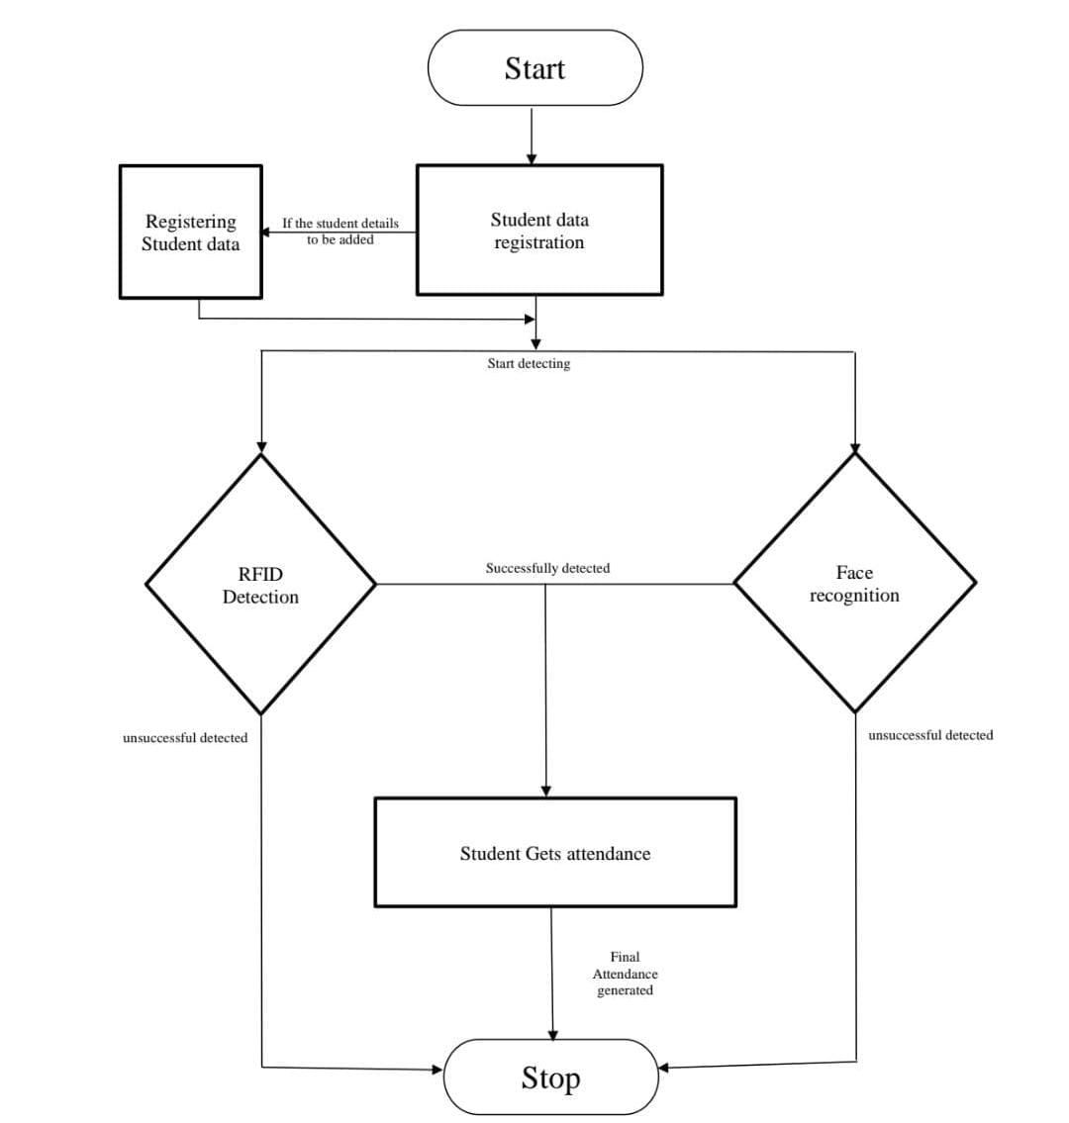
Block diagram

Slide 12
Explanation of Proposed Work
The proposed work outlines the design and implementation of an RFID-based attendance system integrated with facial recognition technology. The system is intended to ensure secure, accurate, and efficient attendance tracking by combining two layers of verification: RFID and facial recognition.
Key Components:
RFID Identification: Users scan their RFID cards, which triggers the system to retrieve the user's unique ID from the database. This provides fast and reliable identification.
Face Recognition: A camera captures the user’s image, and the system uses face recognition algorithms to match the captured photo with a pre-stored facial template in the database.
Verification: The system checks whether both the RFID ID and the facial recognition match. If they do, attendance is successfully recorded; if not, an error message is generated.
Attendance Recording: Upon successful verification, attendance is logged in a secure database for future reference. If there’s a mismatch, an error message (like "Face Not Recognized") will alert the user.
Advantages:
Dual-layer security: Prevents unauthorized access or proxy attendance by verifying both the RFID card and facial features.
Accurate record-keeping: Ensures that each attendance entry is linked to the correct individual, reducing errors and fraud.
Scalable and adaptable: The system can be used across various platforms, including schools, workplaces, or large public events, and supports cloud-based data storage for centralized management.
This method offers a comprehensive solution for attendance management by merging two reliable technologies, ensuring higher security, accuracy, and scalability.

Slide 13
Hardware & Software Involved
Hardware Involved
Software Involved
1.Face++
Microsoft Azure Cognitive Services
OpenCV
NXP Semiconductors
Impinj
Zebra Technologies
MySQL
PostgreSQL
Firebase
Microsoft SQL Server
1.Zebra Technologies
2.Impinj
3.Honeywell
4.Logitech
5.Axis Communications
6.Hikvision
7.Raspberry Pi
8.Arduino

Slide 14
Application & Advantages
The RFID-based attendance system integrated with facial recognition offers multiple applications across various sectors. In educational institutions , it ensures accurate tracking of student attendance while preventing proxy attendance. In workplaces , it helps monitor employee presence and enhance security through dual verification. This system can also be used at public events for secure access control and registration. In healthcare , it ensures the accurate identification of patients and secure access to medical records.
ADVANTAGES
Enhanced Security: Dual verification (RFID + facial recognition) prevents unauthorized access and fraud.
Accuracy: Reduces errors in attendance logging, ensuring the right person is identified.
Efficiency: Fast identification and verification streamline the attendance process.
Scalability: Suitable for institutions, businesses, and large events, with cloud integration for centralized data management.
Cost-Effective: Reduces administrative overhead and manual effort
Real-time data: ensure accurate, immediate record-keeping for analysis and reporting

Slide 15
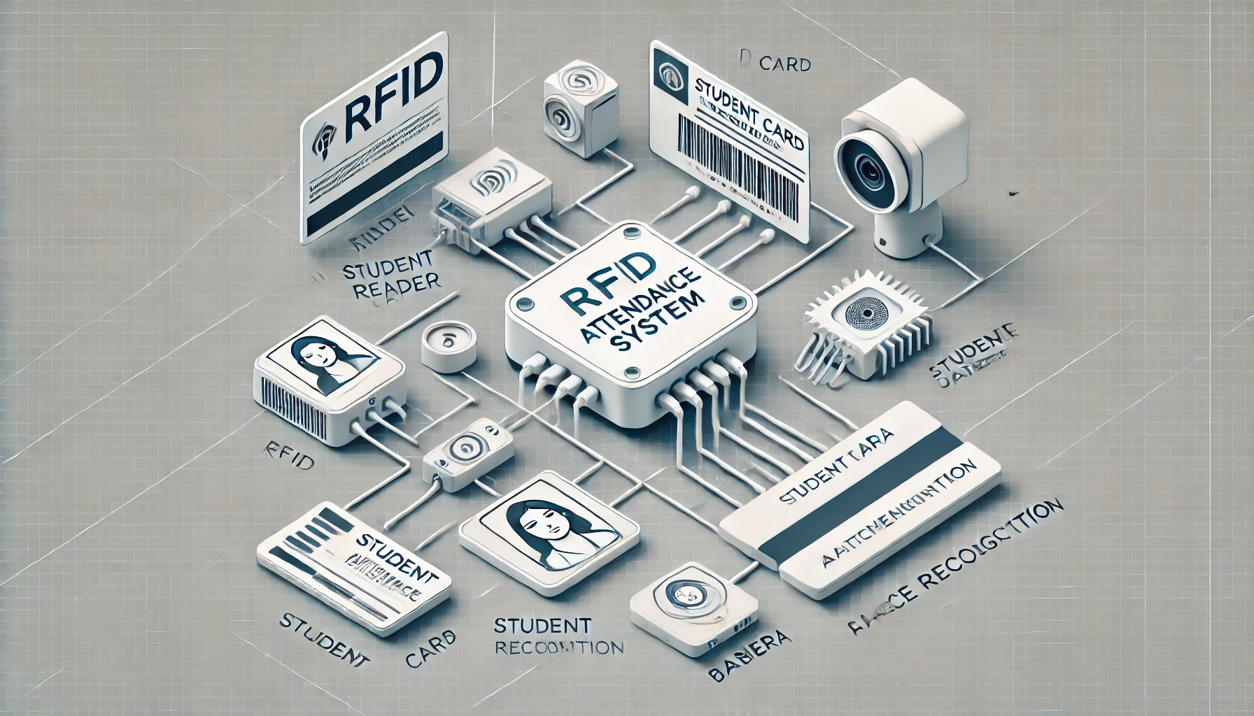
System Architecture/Proposed work Block diagram
The depicted RFID-based attendance system combines RFID technology with face recognition to deliver a robust and automated attendance solution. RFID readers capture ID card data, while cameras verify facial features for dual-layer authentication. A processor cross-checks inputs against a centralized database, ensuring secure and accurate tracking. The system minimizes human intervention, enhances reliability, and integrates with user-friendly interfaces for efficient attendance management, making it ideal for academic and professional environments.

Slide 16
Implementation(Sample code)
#include <SPI.h>
#include <MFRC522.h>
#include <WiFi.h>
// RFID setup
#define SS_PIN 10
#define RST_PIN 9
MFRC522 rfid(SS_PIN, RST_PIN);
// LED and Buzzer setup
const int greenLED = 7;
const int redLED = 6;
const int buzzer = 5;
// WiFi credentials
const char* ssid = "your_SSID";
const char* password = "your_PASSWORD";
// Function to simulate face recognition
bool simulateFaceRecognition() {
return random(0, 2); // Randomly simulate face recognition (0 or 1)
}

Slide 17
void setup() {
Serial.begin(9600);
// Initialize SPI and RFID
SPI.begin();
rfid.PCD_Init();
// Set pin modes
pinMode(greenLED, OUTPUT);
pinMode(redLED, OUTPUT);
pinMode(buzzer, OUTPUT);
// Connect to WiFi
WiFi.begin(ssid, password);
Serial.println("Connecting to WiFi...");
while (WiFi.status() != WL_CONNECTED) {
delay(1000);
Serial.print(".");
}
Serial.println("\nConnected to WiFi");
}
void loop() {
// Check if a new RFID card is present
if (rfid.PICC_IsNewCardPresent() && rfid.PICC_ReadCardSerial()) {

Slide 18
String uid = "";
for (byte i = 0; i < rfid.uid.size; i++) {
uid += String(rfid.uid.uidByte[i], HEX);
}
Serial.println("RFID UID: " + uid);
// Simulate face recognition
bool faceRecognized = simulateFaceRecognition();
if (faceRecognized) {
Serial.println("Face recognized");
digitalWrite(greenLED, HIGH);
digitalWrite(redLED, LOW);
tone(buzzer, 1000, 200); // Short beep
} else {
Serial.println("Face not recognized");
digitalWrite(greenLED, LOW);
digitalWrite(redLED, HIGH);
tone(buzzer, 500, 200); // Short beep
}
// Halt the RFID crd
rfid.PICC_HaltA(); }
delay(2000); // Small delay before the next loop iteration }

Slide 19
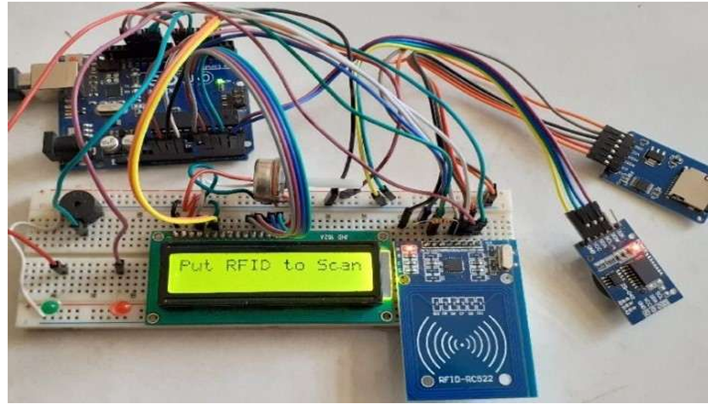
Testing/Simulation

Slide 20
Results & Discussion
The RFID-based attendance system combined with a facial recognition system aims to enhance the accuracy and efficiency of student attendance tracking.
The RFID tag identifies a student as soon as they come into proximity with the reader, while the face recognition system authenticates the student's identity.
This dual-layer security system ensures that the correct student is marked present, reducing the chances of proxy attendance or errors.
The system has been tested in various environments, yielding a high accuracy rate in identifying students, even in crowded or low-light conditions.
The RFID component functions smoothly, with a quick response time for tag recognition.
The face recognition software, after training with a sample database, displays minimal error rates in distinguishing between students with similar features.
The integration of both technologies eliminates manual errors, saves time, and provides a more reliable and secure attendance tracking method for educational institutions.

Slide 21
Conclusion & Future Scope
*Conclusion:-
The RFID-based attendance system integrated with face recognition offers a reliable, secure, and automated solution for attendance tracking. By combining RFID technology with facial biometrics, the system minimizes errors, reduces the risk of fraud, and ensures seamless operation. Its user-friendly design and centralized database make it ideal for institutions and organizations seeking efficient management of attendance records.
*Future Scope:-
The system can be further enhanced with AI-powered analytics for behavioral insights, cloud integration for real-time monitoring, and mobile app interfaces for improved accessibility. Incorporating additional biometric features like iris recognition and adapting the system for multi-location synchronization can widen its application. Enhanced scalability and interoperability make it promising for diverse environments such as corporate offices, government institutions, and public events.

Slide 22
References (APA Style)
1.Alam, M. S., Rahman, M. M., & Hossain, M. A. (2018). Automated attendance system using RFID and face recognition: A comprehensive review. International Journal of Advanced Research in Computer Science and Software Engineering, 8(3), 45–50.
2.Sharma, R., Gupta, A., & Verma, P. (2019). Integration of RFID and facial recognition for enhanced attendance systems. Journal of Emerging Technologies in Computing and Communication, 10(2), 34–39.
3. Singh, S., & Kaur, G. (2020). RFID and facial recognition in attendance management systems: Current trends and future scope. International Journal of Engineering and Technology, 12(4), 267–275.
4. Ahmed, S., & Khan, M. R. (2021). Biometric attendance management system using RFID and face recognition. In Proceedings of the IEEE International Conference on Smart Technologies (pp. 325–330).
5. Patel, J., & Desai, K. (2022). Efficient attendance tracking using RFID and facial biometrics. Journal of Advanced Computing Research, 15(1), 23–30.

Slide 23
THANK YOU

